Slide 1

Hamline Church Youth Service Trip Summer 2025

Slide 2
What is ASP?
Since 1969, ASP has made homes warmer, safer, and drier for families and provided transformational service experiences for volunteers. Each year, more than 15,000 volunteers serve with ASP, providing critical repairs for more than 350 families.
Appalachia Service Project is a Christian ministry, open to all people, that inspires hope and service through volunteer home repair and replacement in Central Appalachia.
Appalachia Service Project envisions the eradication of substandard housing in Central Appalachia and the transformation of everyone who comes in contact with this ministry.

Slide 3
https://www.youtube.com/watch?v=IjmA_gqEI_A
https://www.youtube.com/watch?v=IjmA_gqEI_A

Slide 4



About Appalachia Service Project
Warmer. Safer. Drier.®
ASP volunteers provide high-quality home repair and replacement for Appalachian families
Relationship Ministry
ASP volunteers and families develop life-long relationships
Transformation
Everyone who comes into contact with this ministry is transformed

Slide 5
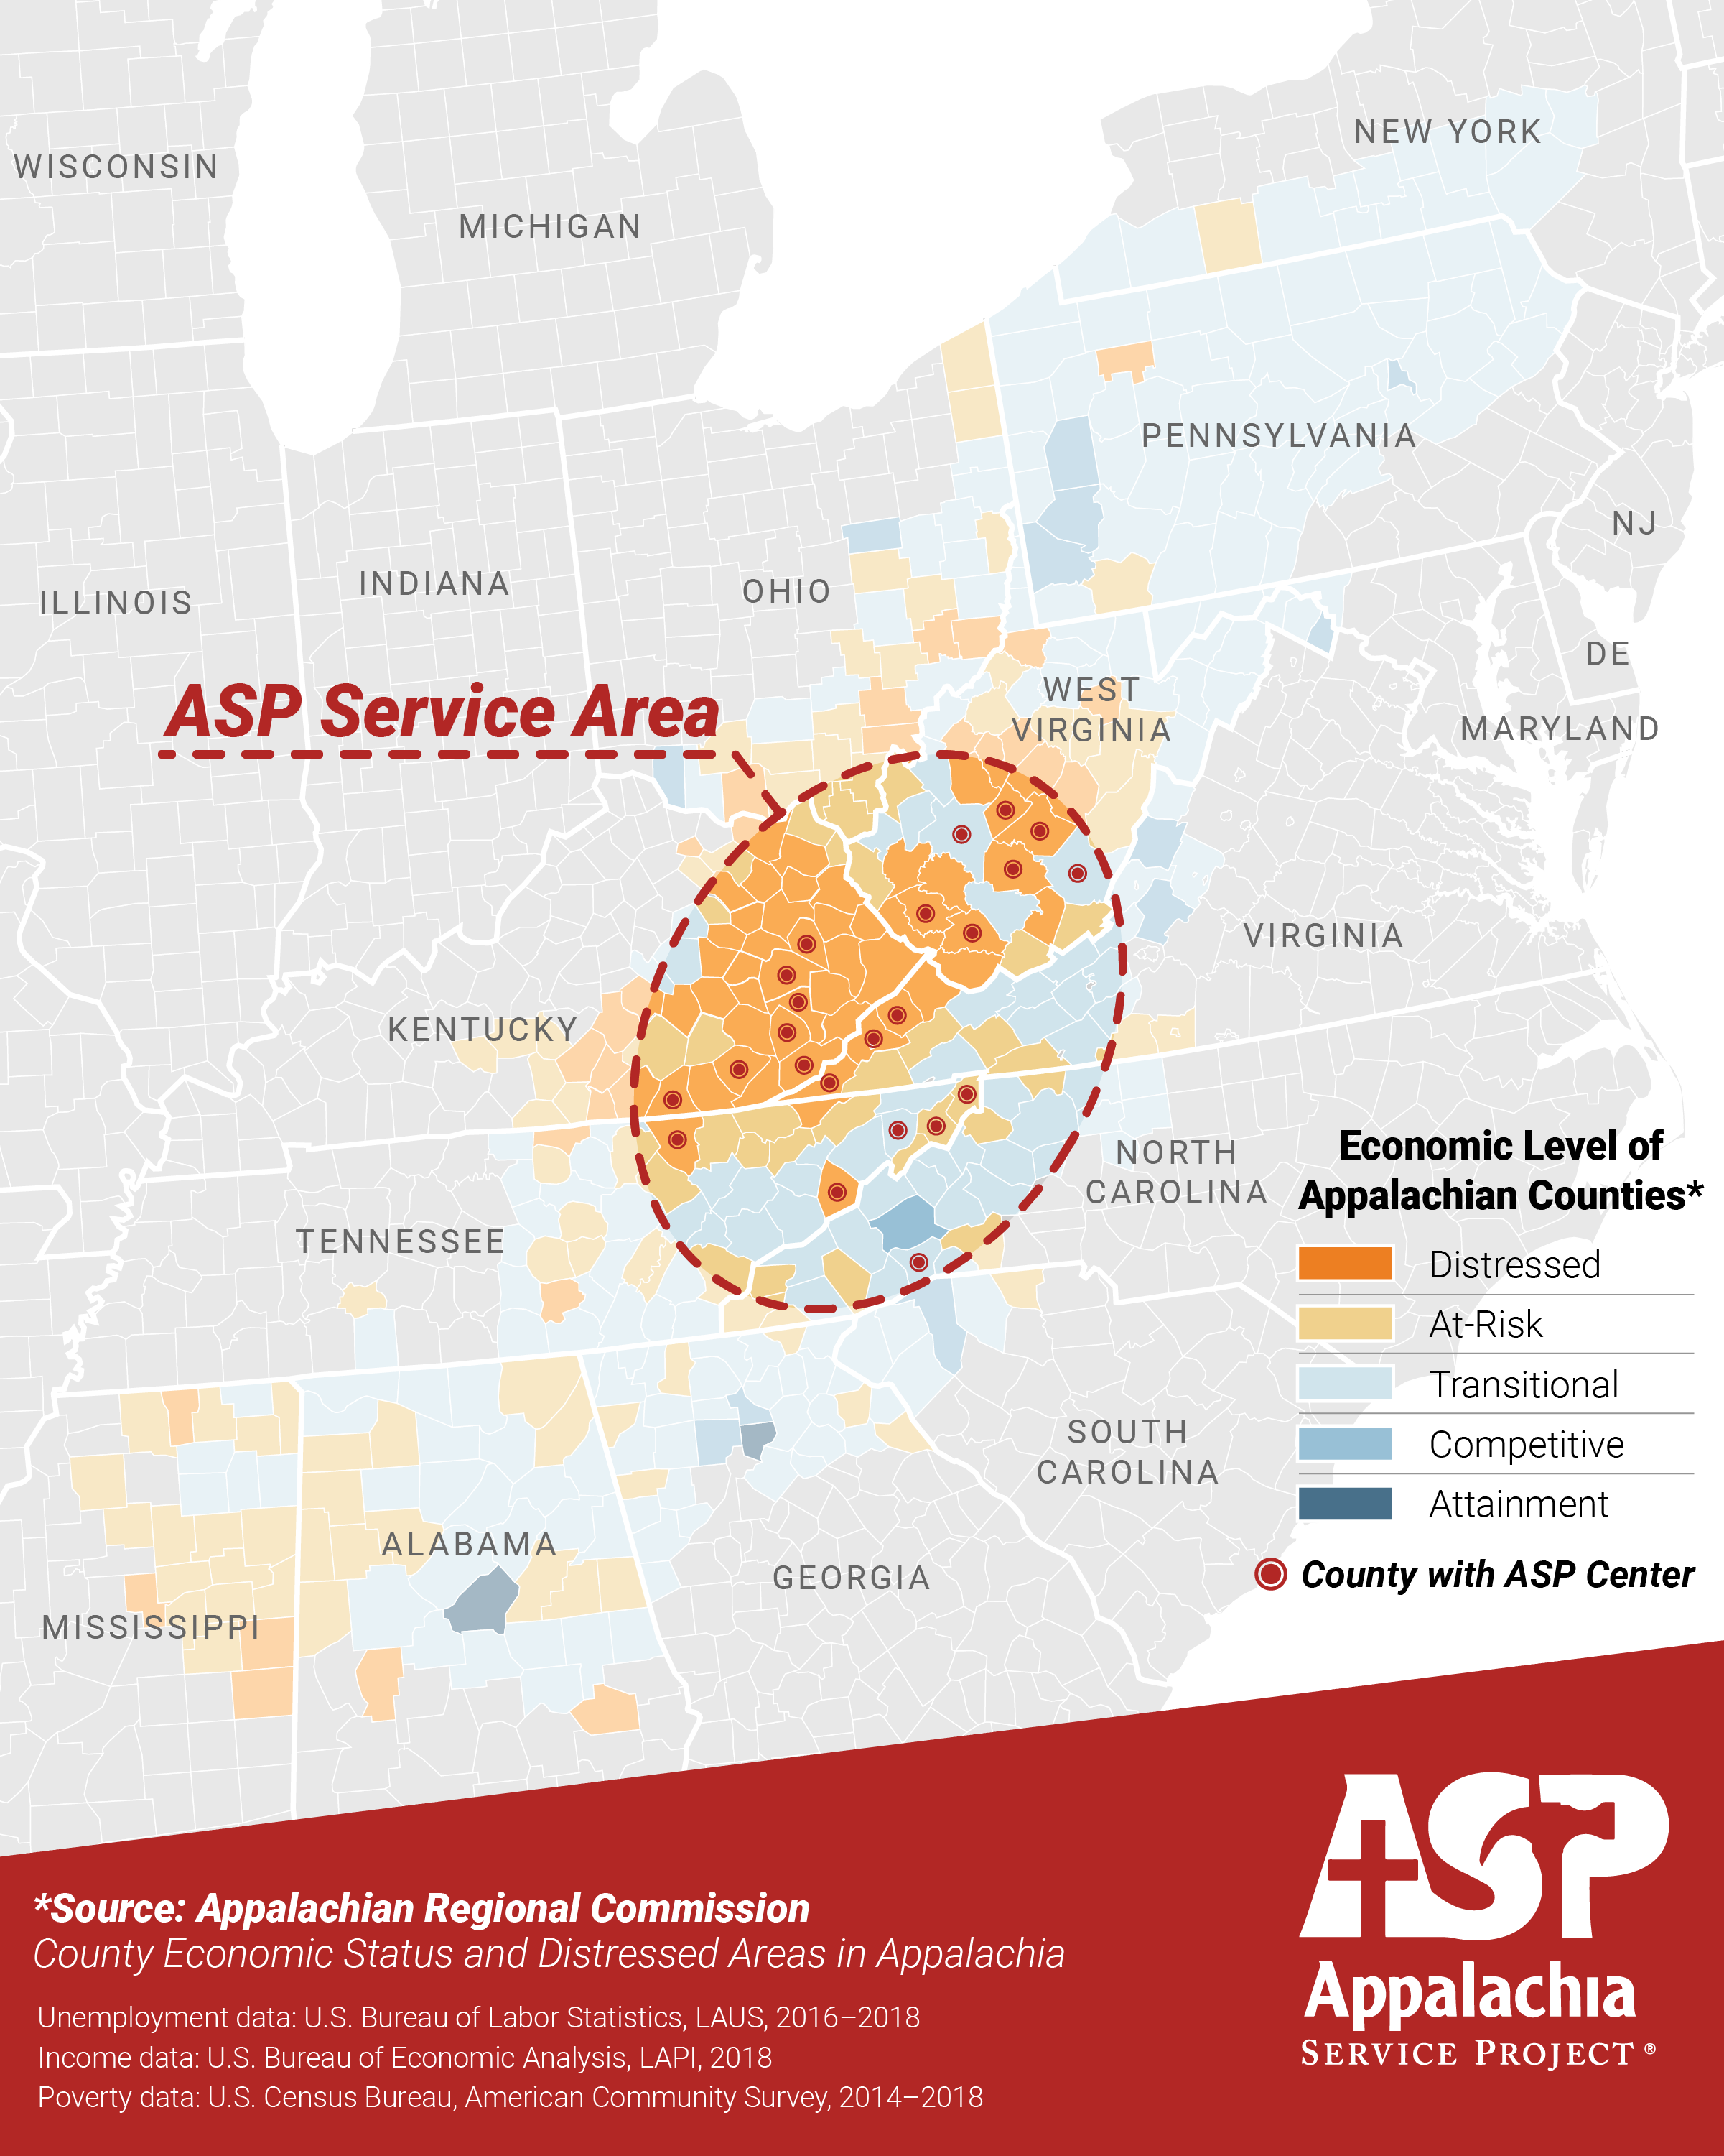
Notes:
ASP believes all people should be able to live in affordable, safe, and sanitary housing. Shelter is a basic human need impacting all areas of life for families. ASP addresses this basic need so families no longer need to worry about leaky roofs, soft floors, or unsafe porches and stairs.
2018 census data shows 11.8% of families in the United States live in poverty. However, Appalachian families experience poverty at a rate of 16% according to the Appalachian Regional Commission (ARC.gov).
ASP organizes mission trips for thousands of youth and adults each year to lend a hand to our neighbors in need in this beautiful region.

Slide 6
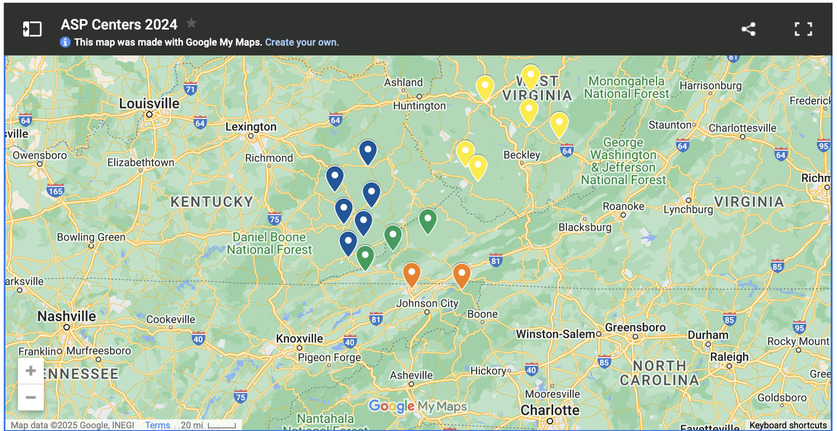

Slide 7
Key Information
Who: Youth grades 6-12
When: July 19-27
Where: Appalachia (specific site TBD in April)
Cost: $600

Slide 8
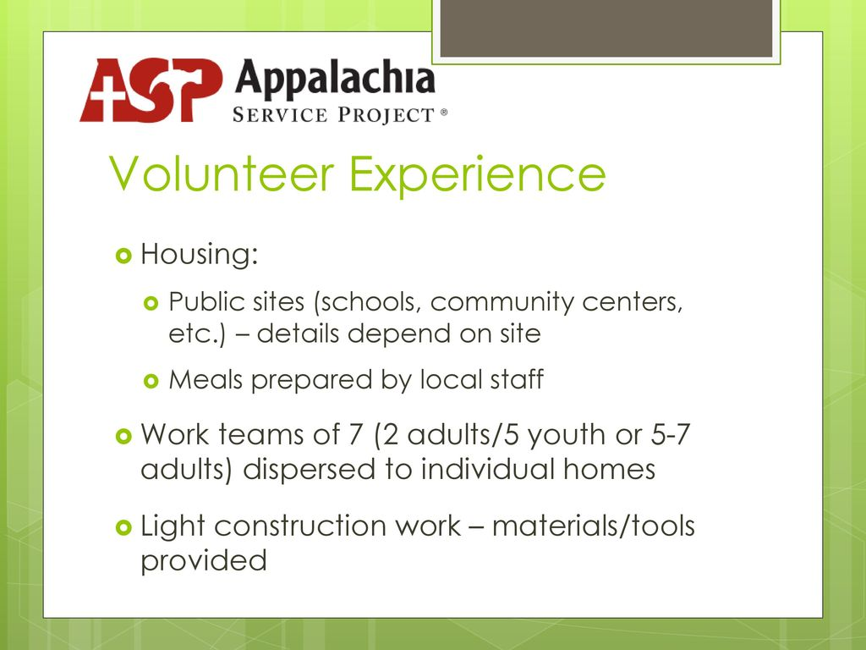

Slide 9
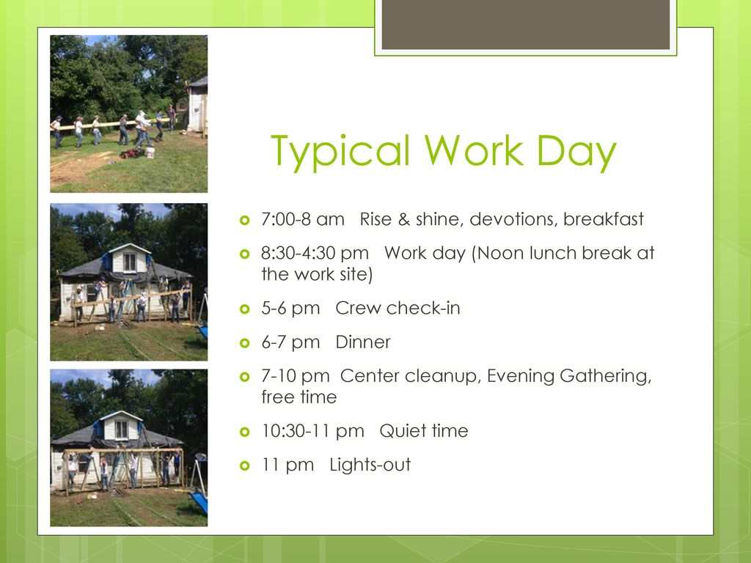

Slide 10
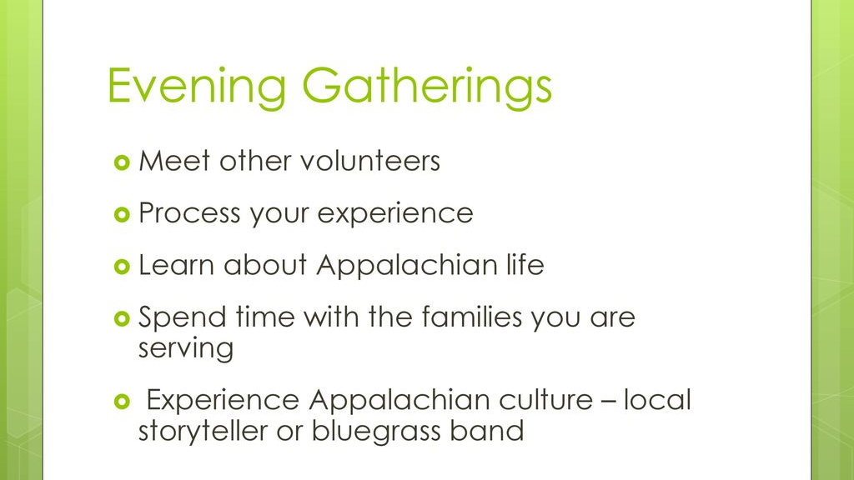

Slide 11
Types of Projects
Warmer
Insulation | The most obvious way to make
a home warmer is to make sure it is properly insulated along its ceiling and exterior walls, and under its floor. Adding insulation to walls and ceilings is pretty straightforward, while floors may involve going under a house or mobile home to install insulation between exposed floor joists. On some homes we install sheets of foam insulation to the exterior of a home before installing siding.
Underpinning or “skirting” | Mobile homes are built on top of wheeled structures that have I-beams and outriggers. This means the floor sits a few feet off the ground. Metal or vinyl sheeting, called underpinning, goes between the bottom of the mobile home and the ground. Without underpinning, wind blows underneath and chills the floor of the home.
Safer
Floors | Leaky roofs or plumbing problems can assault a home’s flooring system. When floors begin to give way, people can fall through. It’s an obvious safety concern for residents and visitors alike.
Porches & ramps | In times of emergency, like a fire, it’s important to have two safe exits from a home. Porches, stairs, and ramps allow families to safely enter and exit their homes daily.
Drier
Roofs | Leaking roofs cause many of the problems ASP seeks to repair. Stopping leaks will halt further damage and protect families from rain and snow.
Drainage | Appalachia’s mountainous landscape means that many homes are built at the bottom of severe slopes. Heavy rains can bring a lot of water against and under foundations. Drainage ditches divert water around homes, helping preserve their foundations.

Slide 12
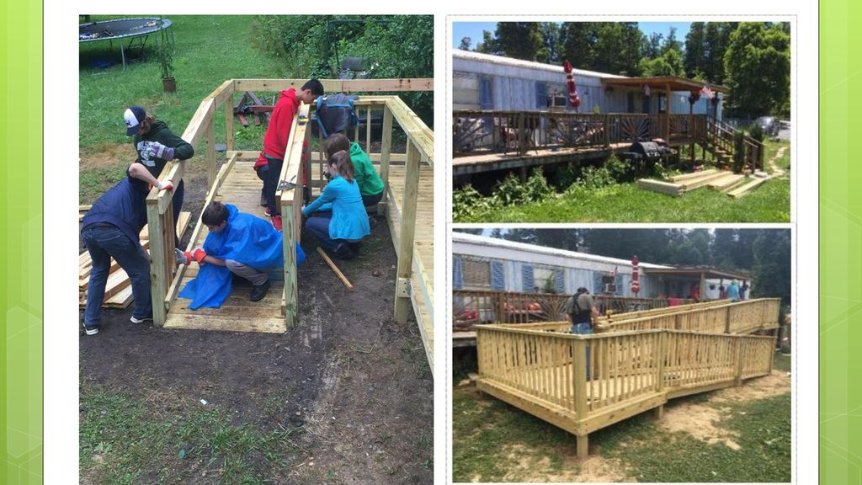

Slide 13
Trip Cost
Total cost: approx. $10,000 - $20,000 depending on group size
$600 per person
$200 deposit due by February 16, 2025
$400 balance due on May 1, 2025
Scholarships are available

Slide 14
Important dates – Your participation in all applicable events is crucial to the success of the trip.
February 16, 2025 Deposit Due
March 16, 2025: ASP participant planning meeting.
April TBD, 2025: Culture and Sensitivity training at church at 6:30pm.
May 1, 2025: Balance of ASP trip fees due. For all participants.
July 8, 2025: Adult leader meeting. For all adult leaders going to ASP.
July 13, 2025: Commissioning Sunday. Commissioning of the group during the church worship service. For all participants.
July 18,2025: Departure meeting, 5:30pm. Drop off your gear for the trip at the church. For all participants.
July 19, 2025: Depart for ASP.
July 27, 2025: Return from ASP.
TBD: ASP Sunday. Highlights of the trip during the church worship service. For all participants.

Slide 15


